Slide 1

Final Year Project : Studying the effects of vision on balance

Slide 2
The hypothesis:
Affecting visual stimuli when a person sways, such that the sway of the stimuli is different from expected, should result in the person having difficulty to balancing.
Excessively affecting visual stimuli however, will have less or no effect on the person’s ability to balance

Slide 3
The core approach
Create a Virtual Reality Environment
By measuring the user’s sway, change the visual stimuli in the environment in a way that accentuates

Slide 4
Wiiboard Justification

Slide 5






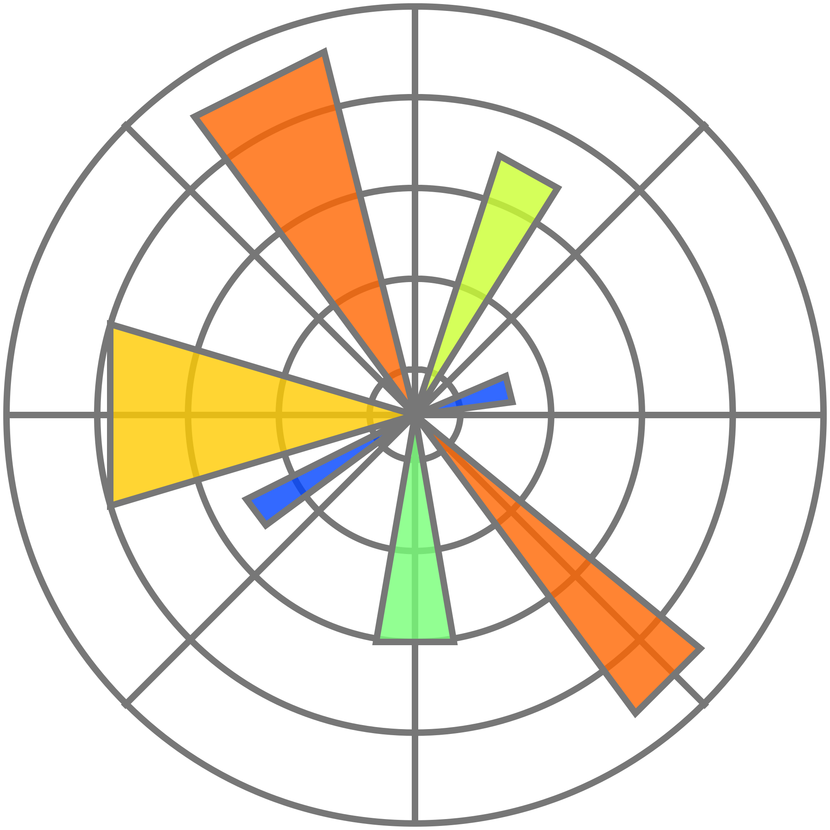
Key technologies
Unity project scene
UDP Socket with Wiimote Library
Python script
Bluetooth
C# UDP Socket
UDP Socket
Wiiboard
SteamVR Unity package
Pimax Virtual reality headset
PiTool
Matplotlib
Unity code
XR Interaction toolkit + OpenVR

Slide 6
Key technologies
Unity project scene
UDP Socket with Wiimote Library
Python script
Bluetooth
C# UDP Socket
UDP Socket
Wiiboard
SteamVR Unity package
Pimax Virtual reality headset
PiTool
Matplotlib
Unity scripts
XR Interaction toolkit

Slide 7

Choice of stimulus

Slide 8
Various Approaches to the Sway Problem
Moving the stimuli

Slide 9
Various Approaches to the Sway Problem
Inverse pendulum camera

Slide 10
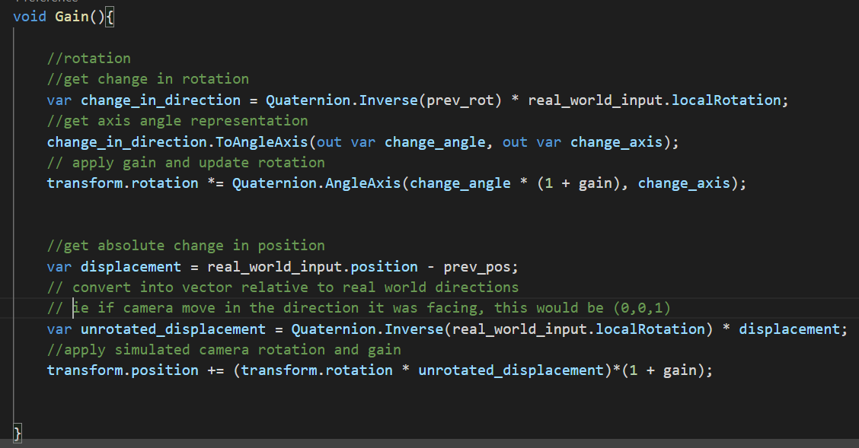
Various Approaches to the Sway Problem
2 parts:
Rotation
Get change in orientation of real – world input
Apply sensitivity
Apply to Simulated camera’s previous rotation
Position
Get Vector of displacement of real – world input
Apply inverse of real – world rotation
Apply Simulated camera’s rotation
Apply sensitivity
Apply to Simulated camera’s position
Changing camera based on VR headset orientation and position change

Slide 11
Demo!

Slide 12
Experiments
How many, what parameters

Slide 13
Experiments Results + analysis

Slide 14
Conclusion

